Slide 1
Microsoft's Acquisition of Activision Blizzard
Mohamad Iskandarani Kamila Khalilullina Anna Surikova Oleg Gonchukov Maksym Bilozorov

Slide 2
Overview and Objective of the Acquisition
Timeline:
Announcement: January 18, 2022.
Regulatory Approvals and Challenges: 2022-2023.
Completion: October 13, 2023.
Key Players:
Buyer: Microsoft (Led by CEO Satya Nadella).
Target: Activision Blizzard (Famous for franchises like Call of Duty and Warcraft).
Significance:
Record-breaking $68.7 billion deal.
Largest acquisition in gaming history.
Objective of the Analysis:
Primary Goal: Evaluate the financial and strategic impact of the acquisition.
Accounting Analysis: Test hypotheses using Microsoft’s and Activision Blizzard’s 10-K filings (e.g., revenue trends, goodwill adjustments, profitability shifts).

Slide 3
Microsoft’s Goals and Challenges
Goals:
Accelerate growth across gaming platforms: Expand its presence in mobile, PC, console, and cloud gaming to tap into growing markets and diversify revenue streams.
Enhance Game Pass offerings: Integrate Activision Blizzard’s popular intellectual properties (e.g., Call of Duty, Warcraft) into Xbox Game Pass to attract more subscribers.
Strengthen competitive positioning: Gain an edge over major competitors like Sony (PlayStation) and Tencent, leveraging Activision’s global reach and established franchises.
Rationale for Goals:
Consolidate Microsoft’s leadership in gaming as a service (e.g., Game Pass subscriptions).
Bridge gaps in mobile gaming capabilities through Activision’s King division (creator of Candy Crush).
Create synergies between Microsoft’s Azure cloud services and Activision’s gaming ecosystem.
Challenges
Slower Revenue Growth
Market saturation and intensified competition limit growth potential.
High Dependency on Established Franchises
Heavy reliance on existing titles like Halo and Minecraft for revenue continuity.
Regulatory Scrutiny
Ongoing antitrust concerns over Microsoft's dominant position in technology and gaming sectors.

Slide 4
Accounting Hypotheses for Analysis
Hypothesis 1: The Acquisition Resulted in Significant Goodwill Recognition
Outcome: Confirmed.
Conclusion:
The acquisition created a significant increase in Microsoft's goodwill, as seen in the Goodwill-to-Total Assets Ratio, which rose from 16.4% to 25.1%. This supports the idea that the premium paid for Activision Blizzard reflects the strategic value of its intellectual properties and brand.
Hypothesis 2: The Acquisition Improved Microsoft's Financial Leverage
Outcome: Confirmed.
Conclusion:
The Debt-to-Equity Ratio decreased from 0.28 to 0.23, indicating reduced leverage. Microsoft managed to finance the acquisition without significantly increasing its debt relative to equity, reflecting strong financial management.
Hypothesis 3: The Acquisition Enhanced Microsoft's Asset Utilization Efficiency
Outcome: Disproved.
Conclusion:
The Asset Turnover Ratio declined from 0.51 to 0.48, suggesting a slight reduction in the efficiency with which Microsoft generates revenue from its assets. This indicates that the integration of Activision Blizzard has not yet fully optimized asset utilization.

Slide 5
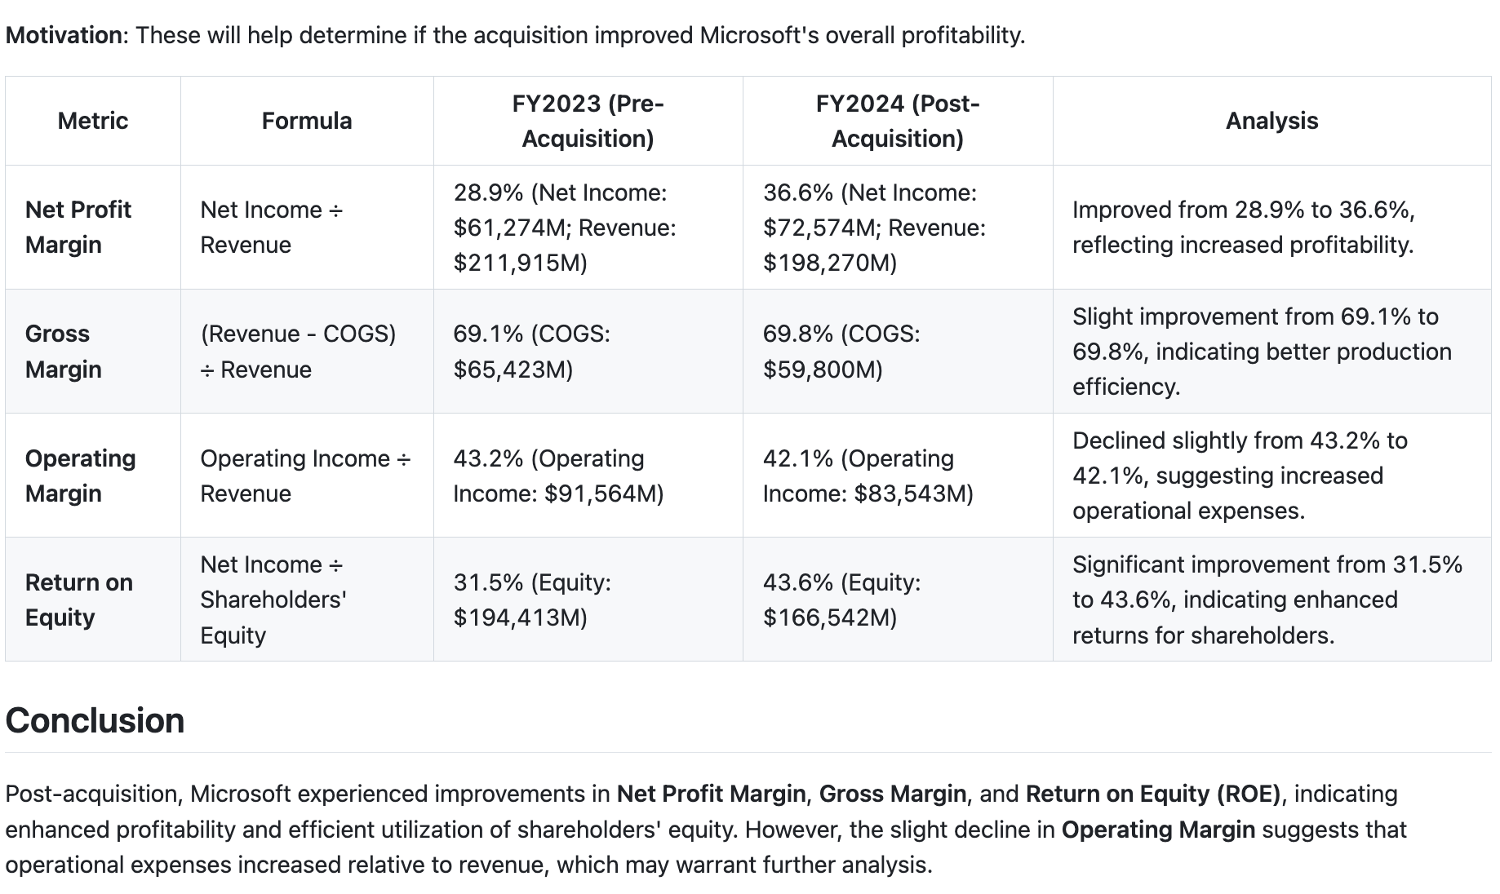
Profitability

Slide 6
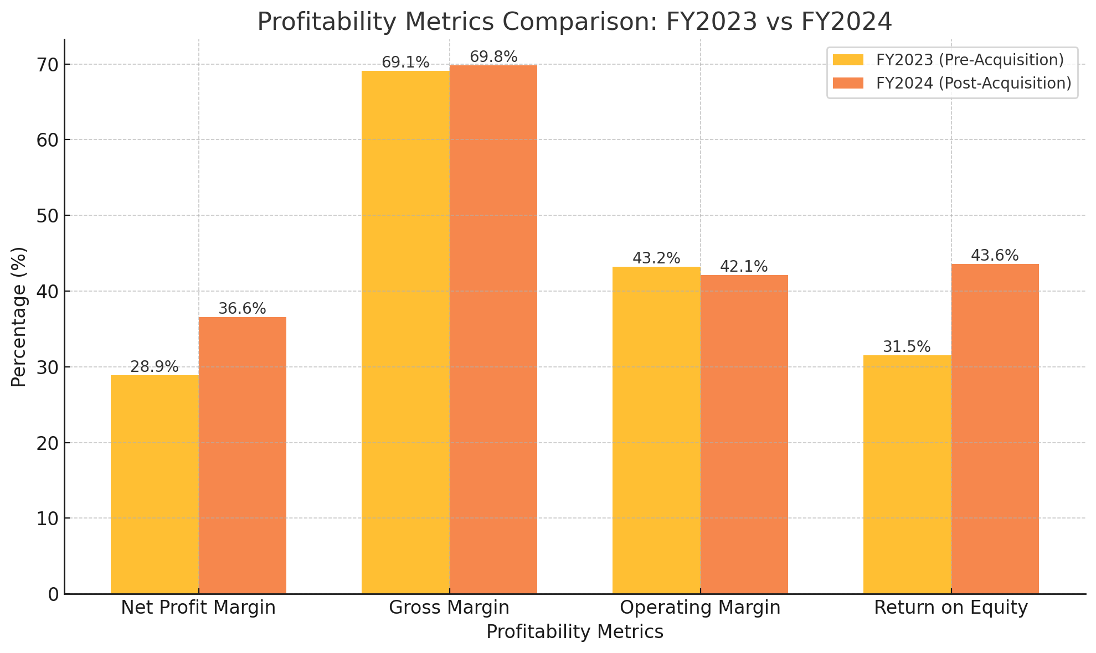
Profitability

Slide 7
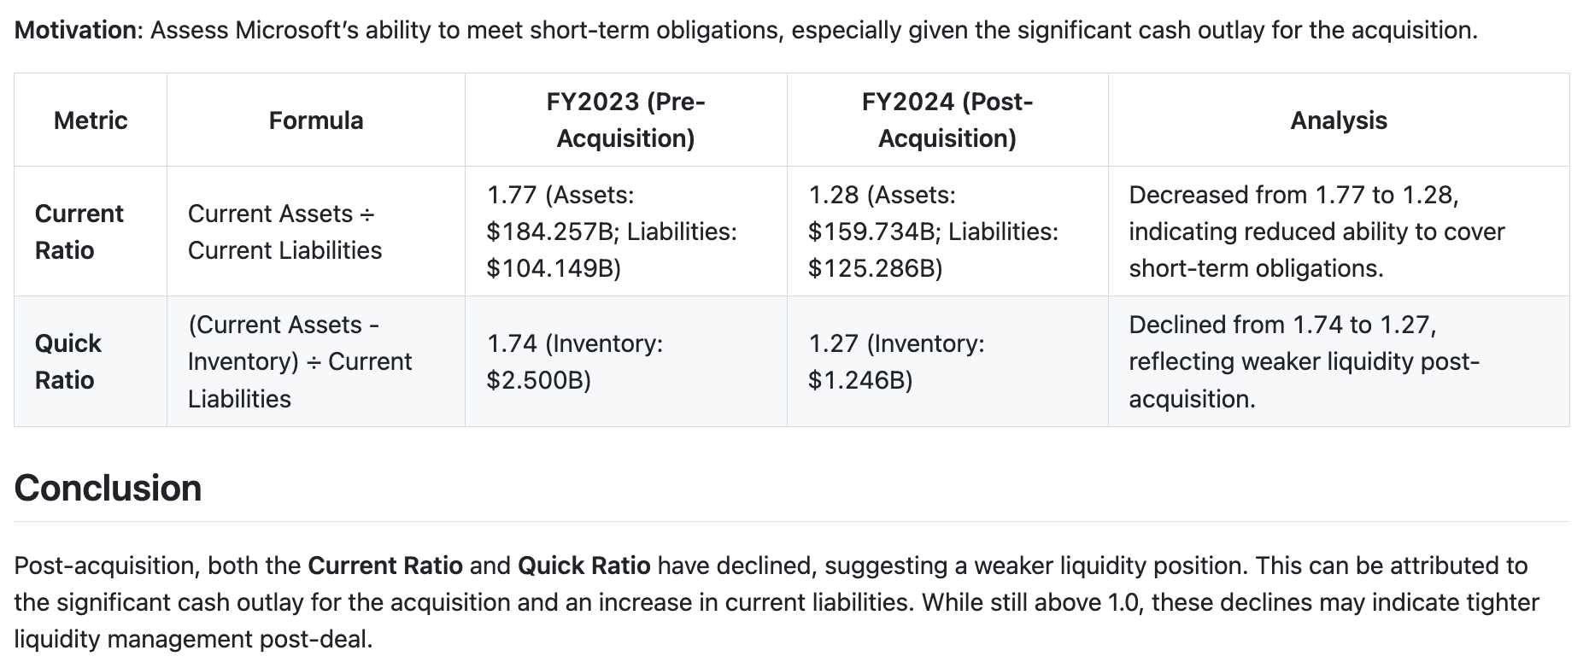
Liquidity

Slide 8
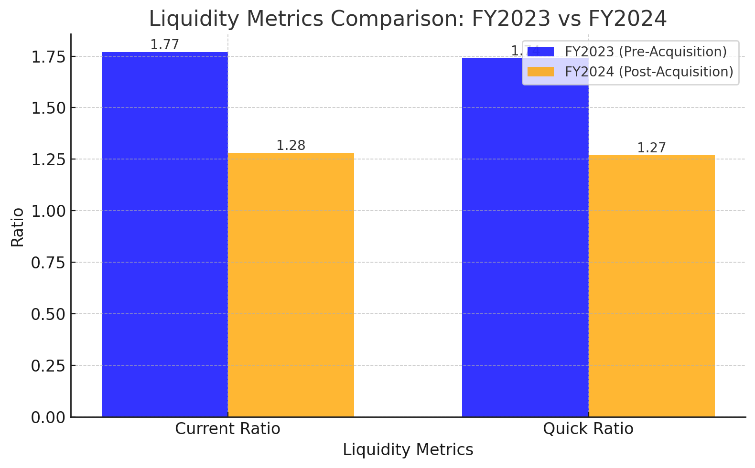
Liquidity

Slide 9
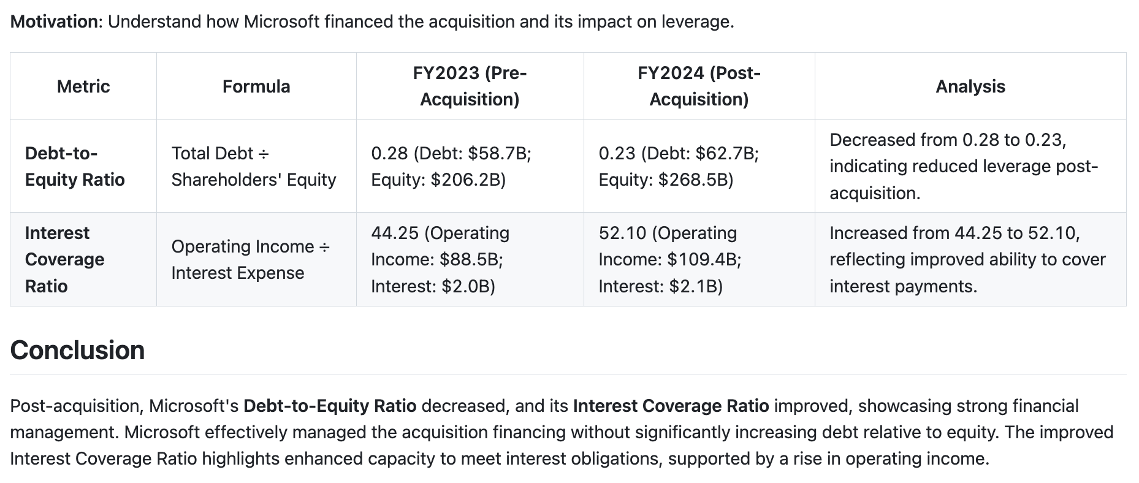
Leverage and solvency

Slide 10
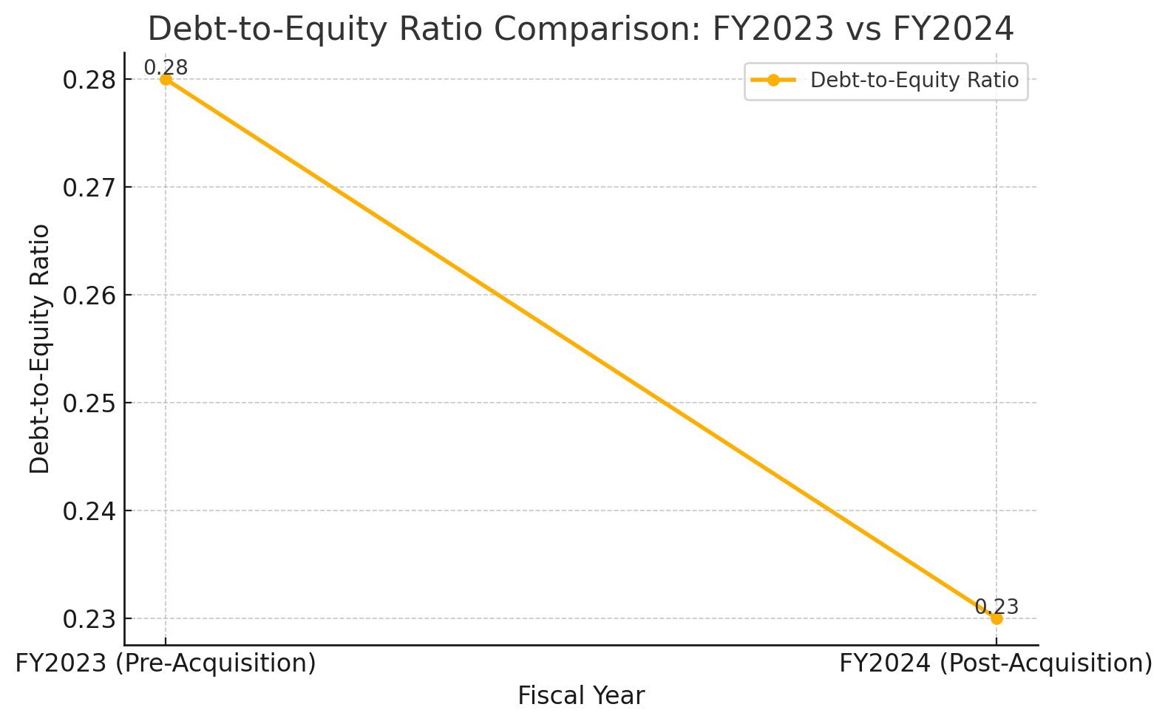
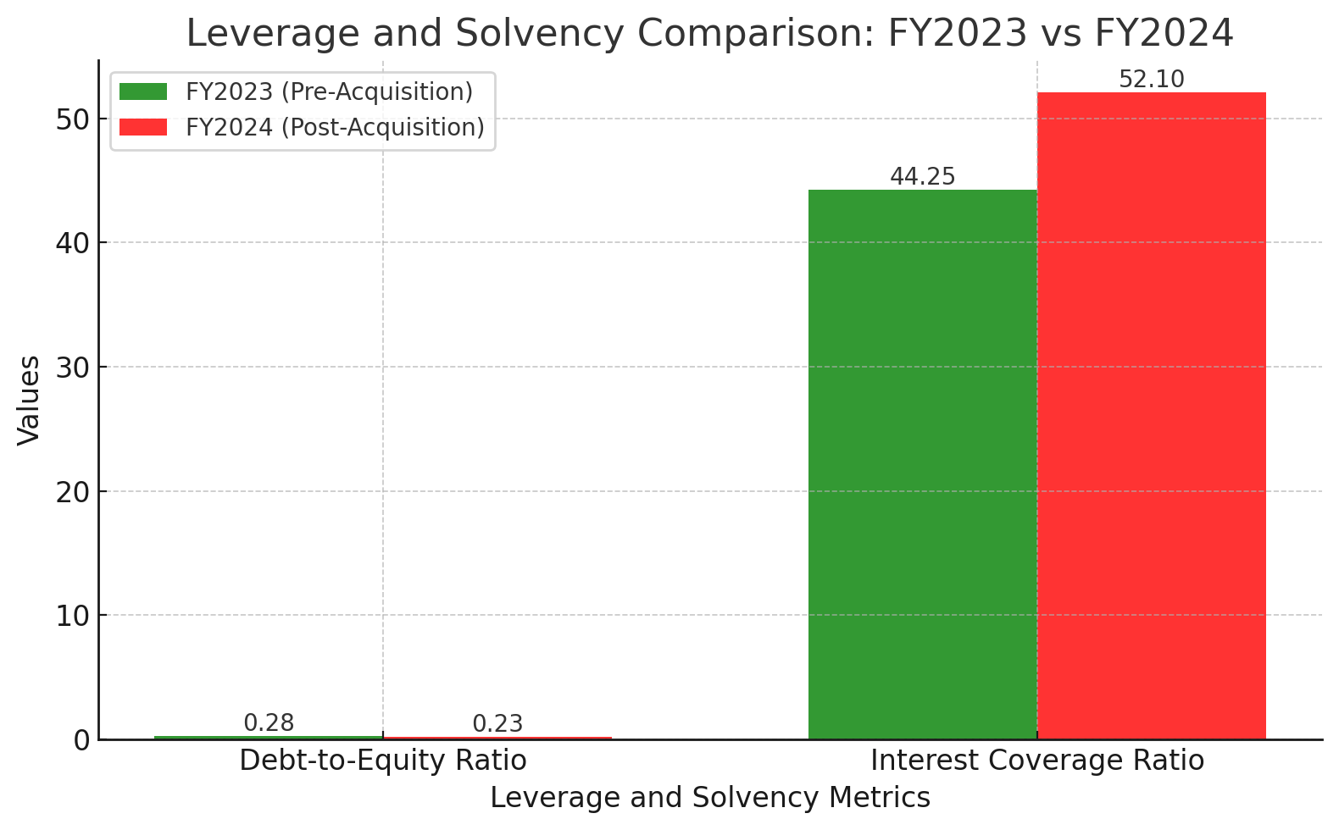
Leverage and solvency

Slide 11
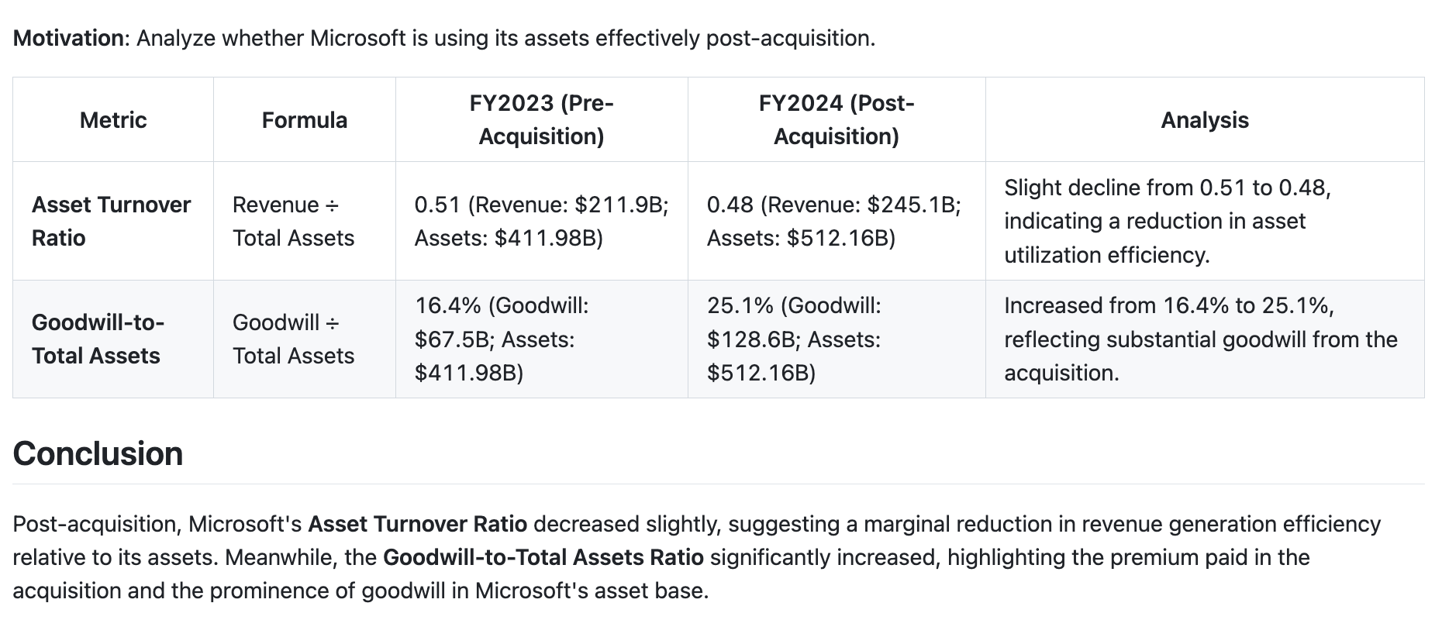
Activity

Slide 12
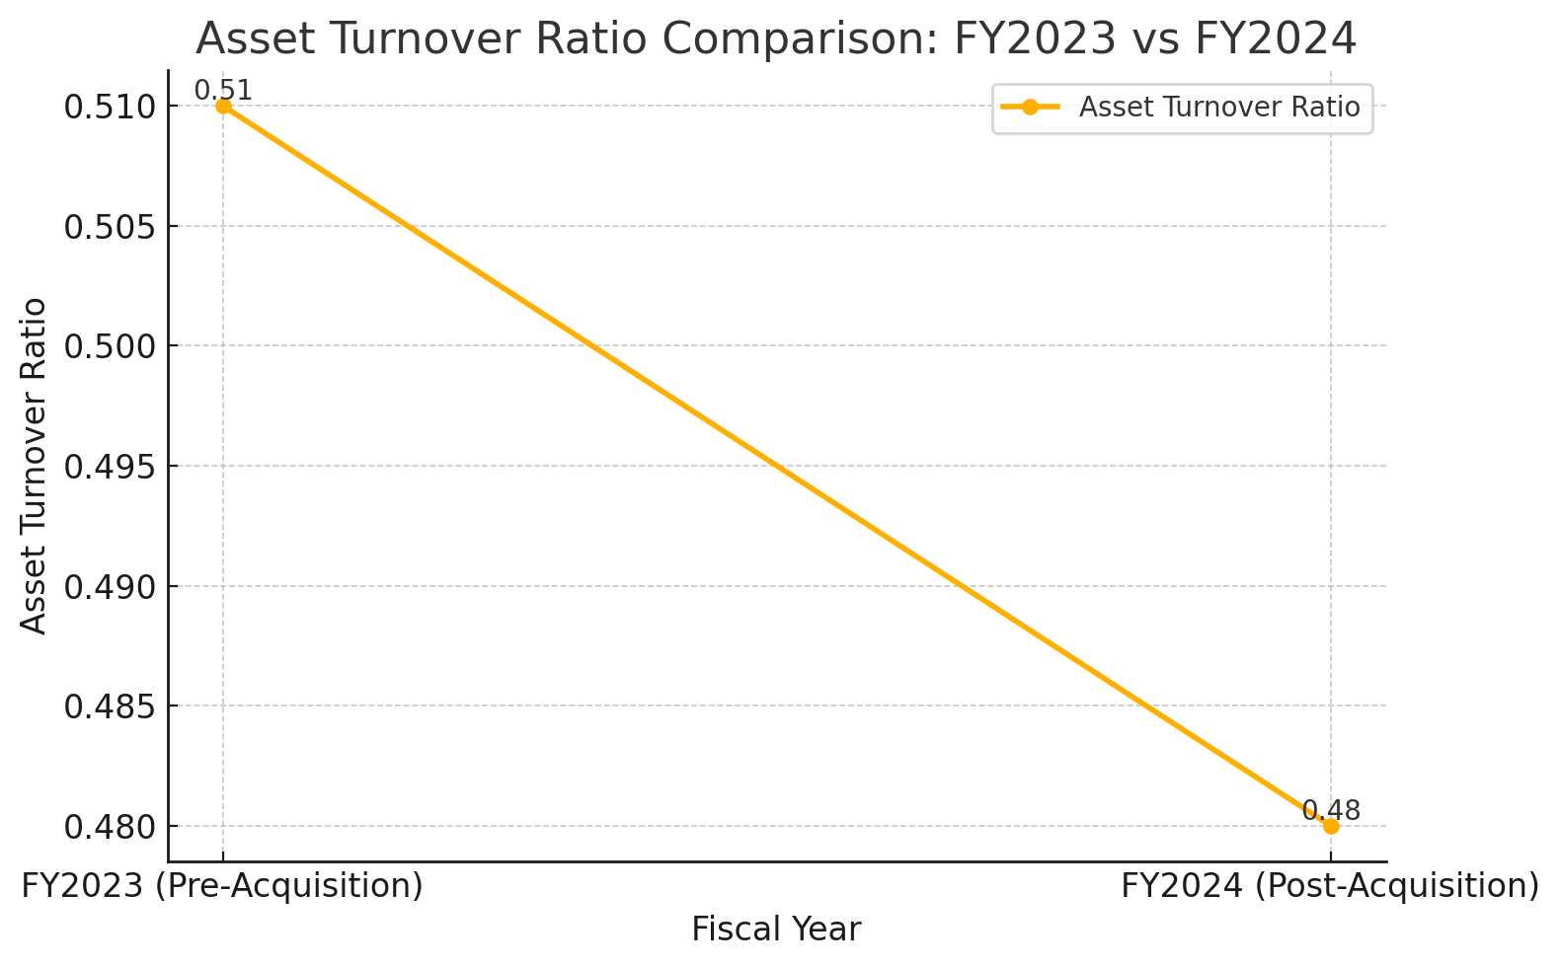
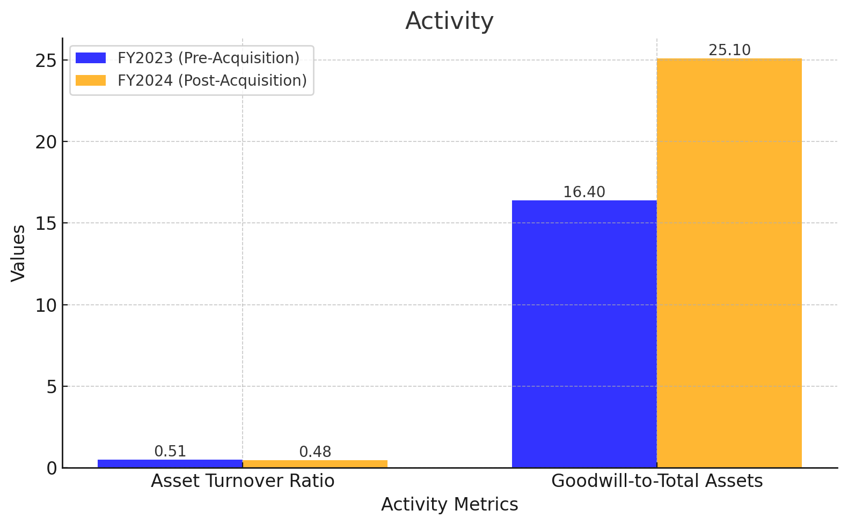
Activity

